Slide 1
Reading Latin America welcoming award-winning children’s literature into your classrooms.
Luciano Marzulli
K-16 Outreach Coordinator

Slide 2
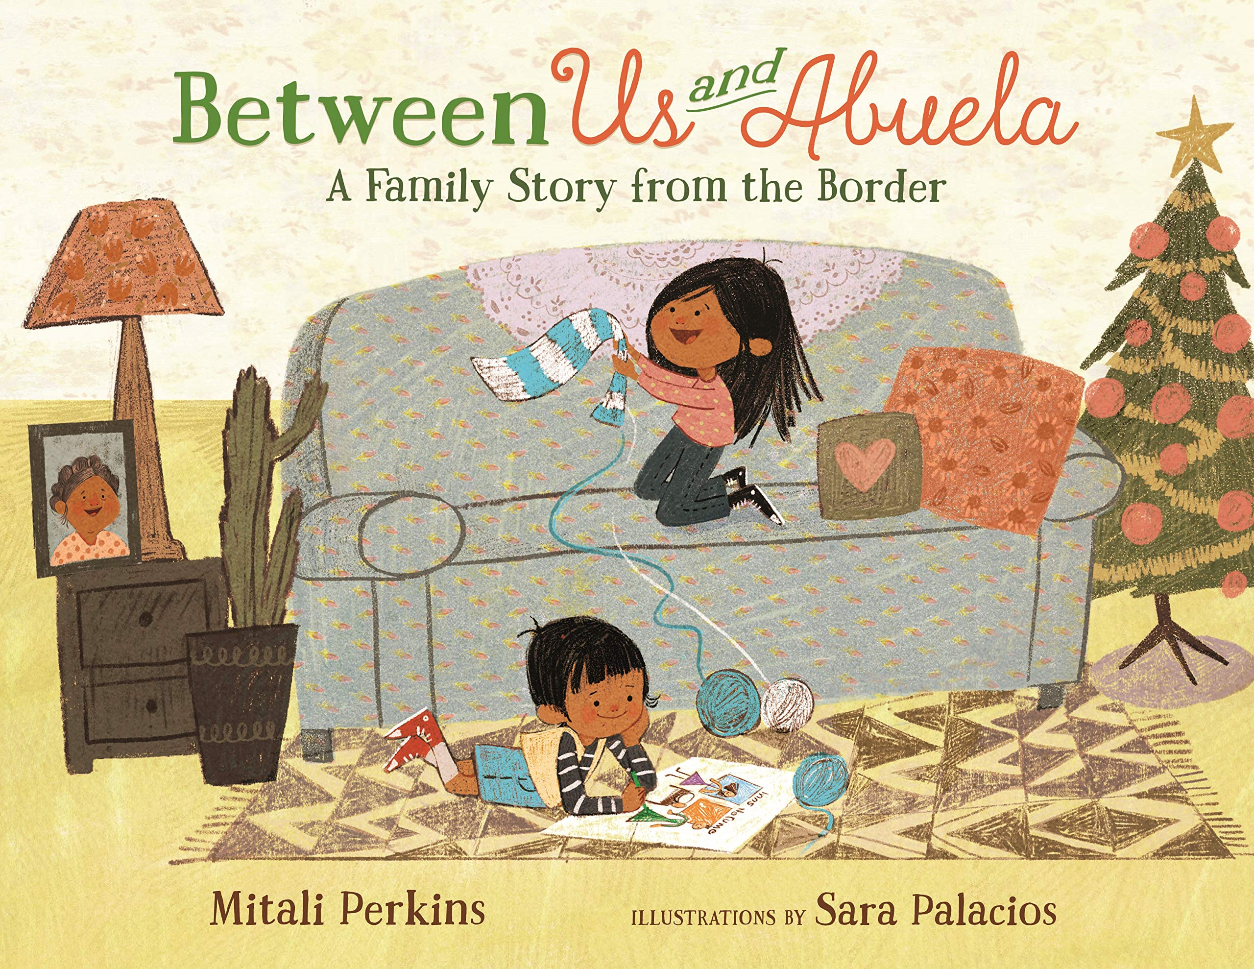
This session will provide an opportunity to take an in depth look at the 2020 Américas Award Winning title: Between Us and Abuela: A Family Story from the Border written by Mitali Perkins and illustrated by Sara Palacios.

Slide 3
Américas Award
CLASP founded the Américas Award in 1993 to encourage and commend authors, illustrators and publishers who produce quality children’s and young adult books that portray Latin America, the Caribbean, or Latinx in the United States, and to provide teachers with recommendations for classroom use. CLASP offers up to two annual book awards, together with a commended list of titles.

Slide 4
Between Us and Abuela: A Family Story from the Border
Siblings, María and Juan, who eagerly anticipate a visit with their Abuela at the US-Mexico border to celebrate La Posada Sin Fronteras. It has been five years since their last visit, so each child is creating something special to give to Abuela, though unsure of how they will pass their gifts through the fence at the border. María creates a beautiful scarf for her grandmother to wear home, and Juan colors a picture of Mary and Joseph, images representing the tradition of Las Posadas. As the visit draws to a close, María devises a plan to share the picture with her grandmother and is encouraged when visitors on both sides of the fence cheer her on. This story is filled with beautiful and vibrant illustrations created by Sara Palacios, a past recipient of the Pura Belpré Illustrator Honor Award. Perkin’s debut picture book is a timely introduction of families separated by borders and will lead to thoughtful conversations of love, determination, family, and hope!
Notes:
Siblings, María and Juan, who eagerly anticipate a visit with their Abuela at the US-Mexico border to celebrate La Posada Sin Fronteras. It has been five years since their last visit, so each child is creating something special to give to Abuela, though unsure of how they will pass their gifts through the fence at the border. María creates a beautiful scarf for her grandmother to wear home, and Juan colors a picture of Mary and Joseph, images representing the tradition of Las Posadas. As the visit draws to a close, María devises a plan to share the picture with her grandmother and is encouraged when visitors on both sides of the fence cheer her on. This story is filled with beautiful and vibrant illustrations created by Sara Palacios, a past recipient of the Pura Belpré Illustrator Honor Award. Perkin’s debut picture book is a timely introduction of families separated by borders and will lead to thoughtful conversations of love, determination, family, and hope! (Grades K-3)

Slide 5
Mitali Perkins
Mitali Perkins has written novels for young readers, including You Bring the Distant Near (a National Book Award Nominee, a Walter Honor Book, A South Asia Book Award Winner, A Publishers Weekly Best Book of the Year, and a Shelf Awareness 2017 Best Book of the Year), Rickshaw Girl (a NYPL Top 100 Book) and Bamboo People (an ALA Top 10 YA novel). Mitali was born in India and currently resides in Northern California.
https://www.mitaliperkins.com
Notes:
Mitali Perkins has written novels for young readers, including You Bring the Distant Near (a National Book Award Nominee, a Walter Honor Book, A South Asia Book Award Winner, A Publishers Weekly Best Book of the Year, and a Shelf Awareness 2017 Best Book of the Year), Rickshaw Girl (a NYPL Top 100 Book) and Bamboo People (an ALA Top 10 YA novel). Mitali was born in India and currently resides in Northern California.

Slide 6
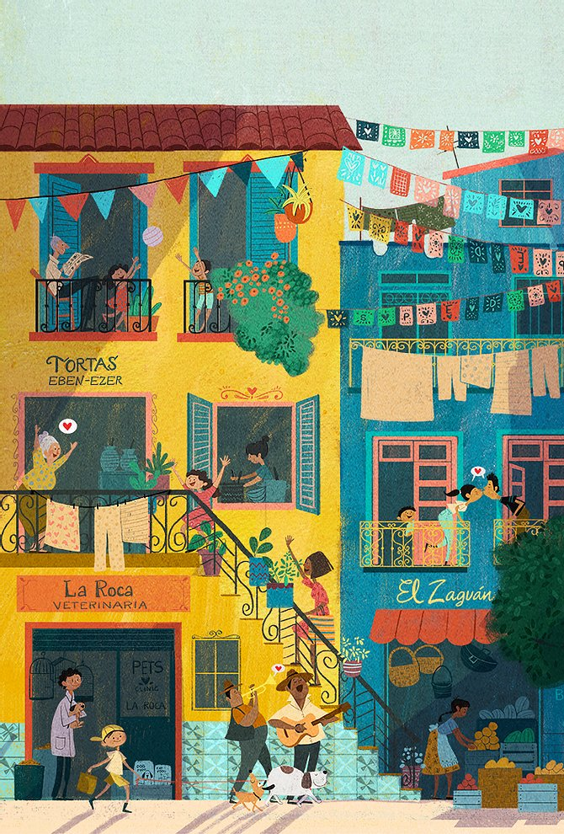
Sara Palacios
Sara Palacios is the recipient of the 2012 Pura Belpré Illustrator Honor Award. A native of Mexico, Sara graduated from the National Institute of Fine Arts in Mexico City and went on to earn BFA and MFA degrees in Illustration from the Academy of Art University in San Francisco. Her books include How to Code a Sandcastle and How to Code a Rollercoaster.
https://www.sarapalaciosillustrations.com
Notes:
Sara Palacios is the recipient of the 2012 Pura Belpré Illustrator Honor Award. A native of Mexico, Sara graduated from the National Institute of Fine Arts in Mexico City and went on to earn BFA and MFA degrees in Illustration from the Academy of Art University in San Francisco. Her books include How to Code a Sandcastle and How to Code a Rollercoaster.

Slide 7
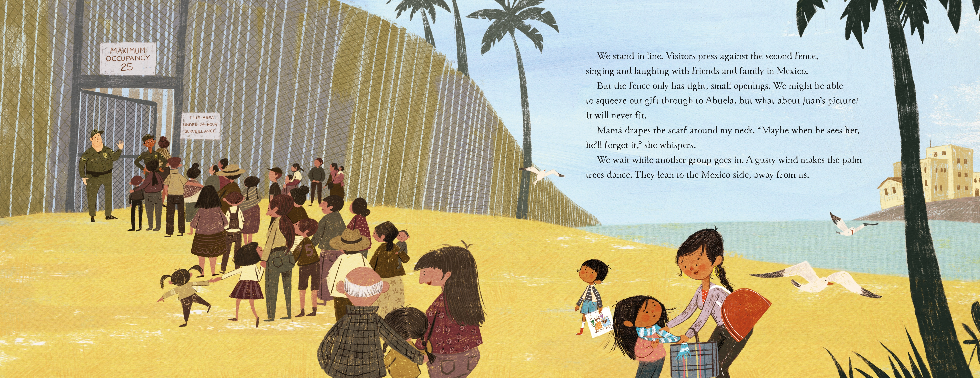
Let’s Read!
Reading of the title with the Author Mitali Perkins. For just the title looks at minute marker 12:55-20:22 on the following link:
https://www.youtube.com/watch?v=HGJyt7EnVWo

Slide 8
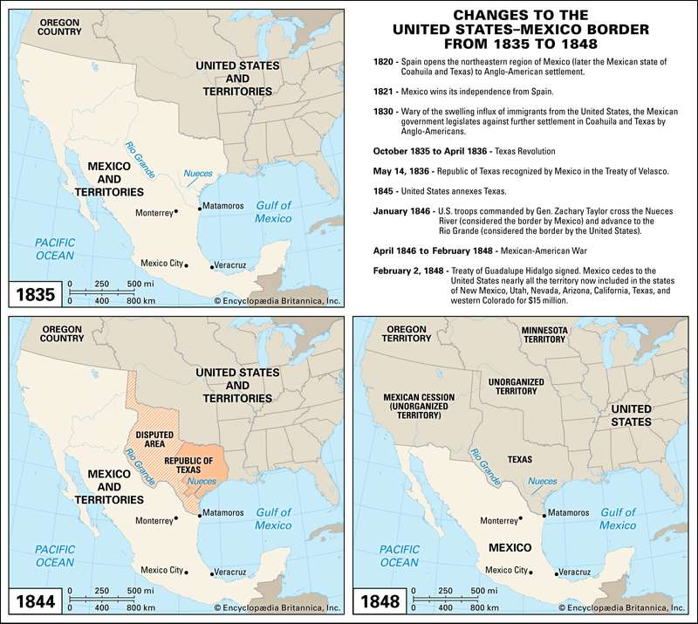
U.S. Mexico Border in Context
Border established with the Treaty of Guadalupe Hidalgo in 1848.
The border region historically and currently traverses several territories of soverign indigenous nations.

Slide 9
Mexican immigration in Context
Immigration from Mexico historically has occured as a result of a lack of employment opportunities in Mexico, push factors, as well as the need of U.S. Instustries and agriculture to employ laborers, pull factors.
Of particular note are:
The influx of Mexicans fleeing the political turmoil during the Mexican Revolution, 1910-1917.
The Bracero Program that lasted from 1942-1964 in which Mexican laboreres were contracted guest workers.
The ecenomic upheaval caused by the The North American Free Trade Agreement (1994) leading to the most recent and sustained influx of immgrants from Mexico for a decade, arguably longer.

Slide 10
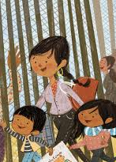
Additional Readings & resource links…
UC San Diego Border Studies Resources:
https://ucsd.libguides.com/c.php?g=408733&p=3091512
How the Border Between the United States and Mexico Was Established
https://www.britannica.com/story/how-the-border-between-the-united-states-and-mexico-was-established
One page overview on CLASP website:
http://claspprograms.org/uploads/Between_Us_and_Abuela-1603808312.pdf
Recording of a book talk with Mitali Perkins:
https://www.youtube.com/watch?v=HGJyt7EnVWo
An exploration of Border Walls
https://www.kcet.org/shows/artbound/a-brief-history-of-border-walls
Mexican Immigration to the United States
https://oxfordre.com/americanhistory/view/10.1093/acrefore/9780199329175.001.0001/acrefore-9780199329175-e-146#acrefore-9780199329175-e-146-div1-5

Slide 11
Américas award resources
CLASP website
http://claspprograms.org/pages/detail/86/Americas-Award-

Slide 12
READ U
Curated book sets through the College of Education:
http://readu.utah.edu

Slide 13
Let’s work together!
Luciano Marzulli
l.marzulli@utah.edu
K-16 Outreach Coordinator
Center for Latin American Studies
801.581.6518
http://ias.utah.edu

